Slide 1

Non-Emergency Phone Number Directory
Gus Lipkin, Luis Moraguez, Nathaniel Fuller, Ahna Cecil

Slide 2
How can we make non-emergency police phone numbers more accessible to people in need?

Slide 3

The who, what, why, and how

Slide 4
What is it we’re actually building?
Based on your current location, our app will serve you information, primarily the non-emergency phone number, for the Sheriff’s office for the county you are in and a quick way to access information for Sheriff’s offices in adjacent counties just in case

Slide 5
What is a non-emergency number?
Non-emergency phone numbers are the regular police numbers that you can call for things that aren’t emergencies (duh)
Need to find out how to pay a ticket
People are parked on your lawn
Etc.

Slide 6
Who wants this?
You do!

Slide 7
Why do I want this?
Non-emergency numbers can be hard to find
You might not know which city or county you’re in and so don’t know what to search for
You want a quick and easy way to find your current non-emergency number and make a call

Slide 8
How are we going to do this?
Let’s find out!

Slide 9

Does anything similar already exist?

Slide 10
No ☹
Police1.com has a list of phone numbers for the largest cities in Florida, but nothing as complete as we were hoping for

Slide 11

Literature Review

Slide 12
Directory vs Database
Directory
Database
Hierarchical
Fast query speed
Data can be changed in multiple places at the same time
Changes to layout must be done through a change in schema
Changes in schema cannot be undone once made [1]
Traditional table format
Fast write speed
Data cannot be changed in multiple places at the same time
Changes to layout can be done at any time (no schema) [1]
Differences between Directory Services and Databases. Tech Direct Archive. (2019, December 18). Retrieved November 19, 2021, from https://techdirectarchive.com/2019/12/18/differences-between-directory-services-and-databases/.

Slide 13
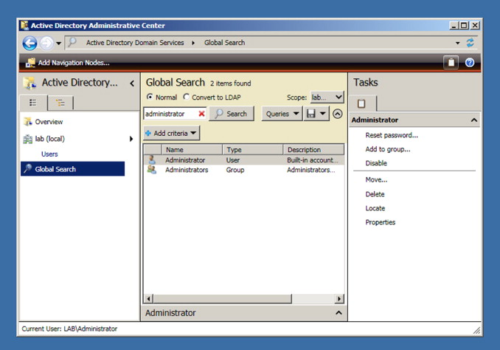
Directory AND Database
Active Directory
The first directory and database combination [1]
Built on Windows 2000 by Microsoft [1]
First to combine usability of a directory structure with simplicity of a database [1]
Presents a hierarchical structure to users, data is still stored in a traditional database format [2]
A Brief History of Microsoft's Active Directory. AJS Networking. (2017, March 8). Retrieved November 19, 2021, from https://www.ajsnetworking.com/microsofts-active-directory/.
Hannifin, D., Alpern, N. J., & Alpern, J. (2010). Active Directory. Science Direct. Retrieved November 19, 2021, from https://www.sciencedirect.com/science/article/pii/B9781597495783000049.

Slide 14
Contact Database
Traditional
Our Usage
Used for businesses to maintain information of sales contacts (i.e. names, addresses, tracking) [2]
Allows the organization to manage and organize important information [1]
Stores information for different Sherrif's Offices non-emergency numbers
Location, jurisdiction, contact numbers
Does not track interactions, only maintains crucial information to supply the user with appropriate contacts
Creating Microsoft Access Contact Management Database. Software Matters. (n.d.). Retrieved November 19, 2021, from https://www.software-matters.co.uk/creating-ms-access-contact-management-database.html.
Contact Database. Experian. (n.d.). Retrieved November 19, 2021, from https://www.edq.com/glossary/contact-database/.

Slide 15
Our Implementation
Inspired by the usability of Active Directory and a typical contact database
Program behaves like a directory to the user but is backed by the database services
Allows user to submit a request through a directory format based on their location and need (utilizing a hierarchical structure)
Request then is passed through the three databases to produce a result

Slide 16

Our Databases

Slide 17

PostgreSQL

Slide 18
Why we chose PostgreSQL
Great for storing detailed properties where enforcement of the structure of data is important
Agency details won't change very often, so fast writing speed is not a factor, but quality/consistency of the data is
Details can be quickly served with proper indexing set up

Slide 19
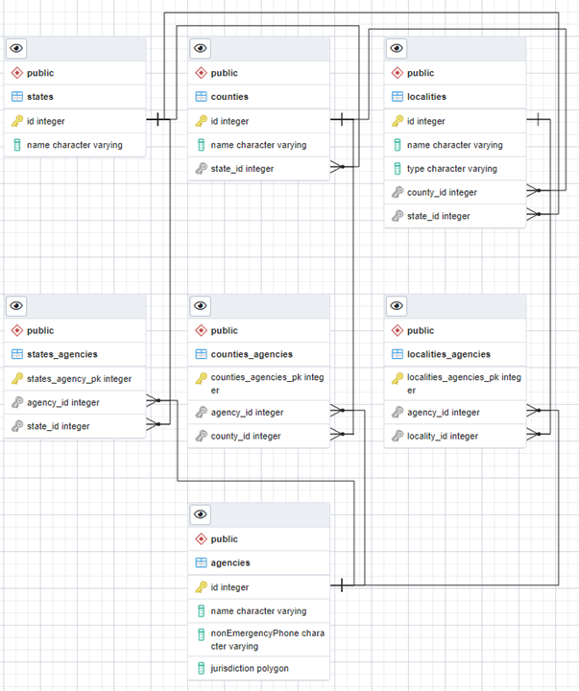
How we’re using PostgreSQL
Querying the detailed properties for the nearest and surrounding agencies.
Based off user location, query comes from Redis and Neo4J to get the details of those agencies

Slide 20

Redis

Slide 21
Why we chose Redis
Pass in memory information to Postgres and Neo4j
Query doesn't need to be saved, just passed
In-memory cache to decrease data access latency, increase throughput, and ease the load off our relational Database

Slide 22
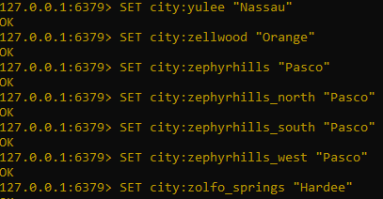

How we’re using Redis
Redis for mapping towns/cities to counties
Fast and easy access to county information
In memory storage to collect the county of the user to be passed to the other databases

Slide 23

Neo4J

Slide 24
Why we chose Neo4J
Neo4J is a graph database, relationships are more important than the data itself
It can be scaled to very large sizes and retains its lightning-fast operation speeds
It is consistent and available, both traits are very important in emergency management

Slide 25
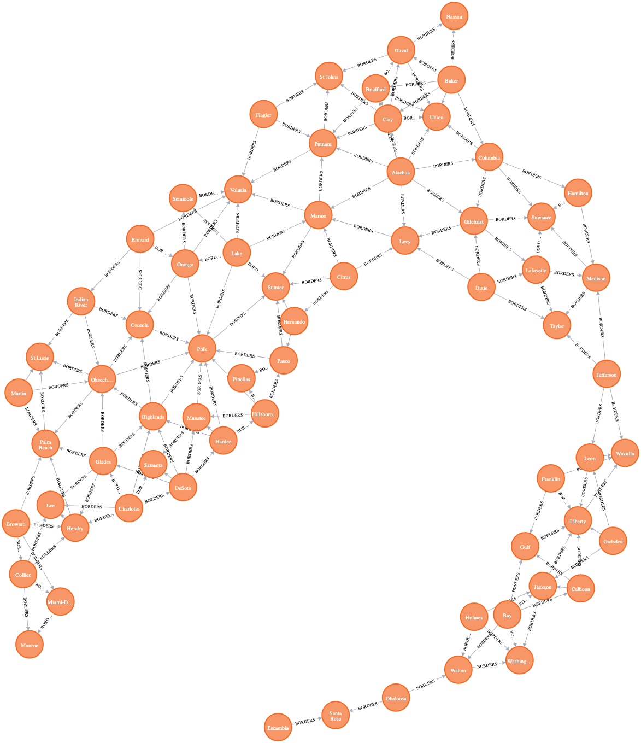
How we’re using Neo4J
Tells you which counties are adjacent
This includes corner connections such as Polk and Manatee counties

Slide 26

Next Steps

Slide 27

Expanded Features
Coordinate based locations for better adjacent recommendations
A more reliable way to pull agency data in case of changes

Slide 28
Potential Features
Expanding on the core concept, information from other law enforcement agencies and points-of-interest can be provided
Personal Trusted Contact Network

Slide 29
Non-Emergency Phone Number Directory
Gus Lipkin, Luis Moraguez, Nathaniel Fuller, Ahna Cecil

